Slide 1
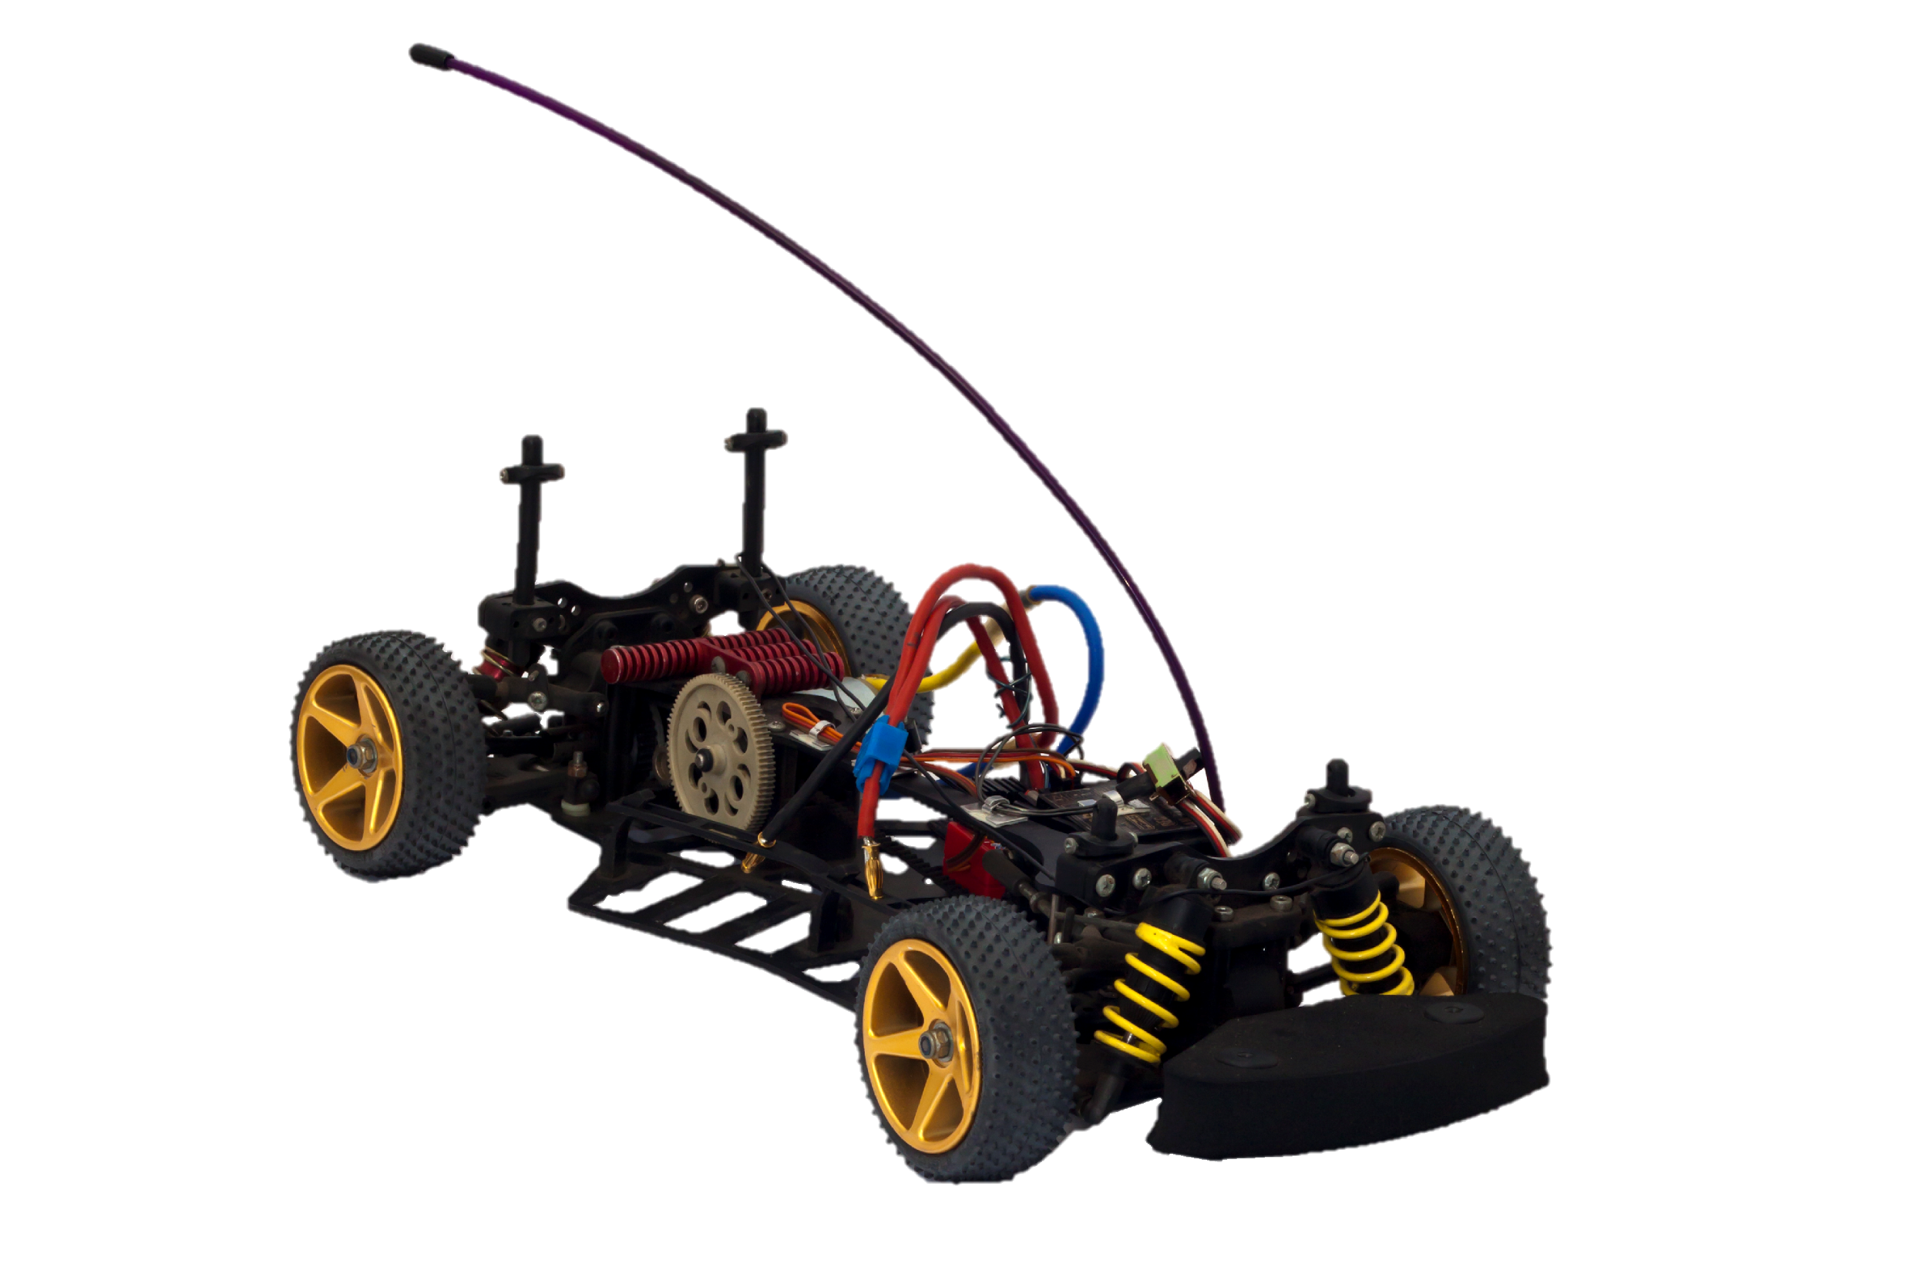


XLR8 Mechanical Session

Slide 2

How to get Started?
Before you start making your bot, you need a proper plan. (Arbit bot nahi chaiye :P)
Depending on the properties (mainly dimensions and mass) of all your components, design a bot either on paper or on a computer (use SolidWorks for infi studdness).
Please do NOT forget your laws of physics, as they come in handy quite often while designing/ making your bot.
Constantly try to the imagine the bot moving in your mind (a.k.a simulate the model), and try to ask yourself, “What could go wrong?”

Slide 3
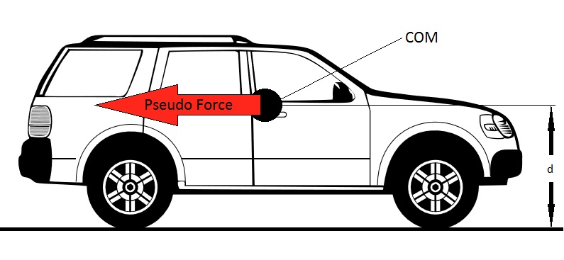
Centre of Mass
Keep it at the center and as low as possible. (It wouldn’t hurt to draw some FBDs at this stage :P)
This is very important for stability, i.e. to prevent the bot from toppling and thereby damaging its exposed electronics.
Try to simulate the following scenarios:
Negotiating inclines or jumping. (try calculating the highest slope your bot could climb assuming you have infigod motors)
Facing impulsive inertial forces at the start of acceleration. (#wheelie)
Over toppling while applying sudden brakes. (#stoppie :P)

Slide 4

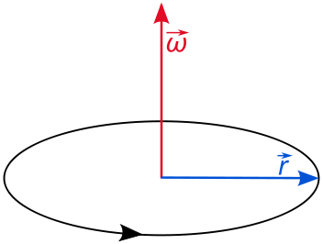
Wheels

Slide 5
Mecanum wheel
Advantages
The core wheel can rotate around its axis like any normal wheel, but now that there are additional wheels perpendicular to it, the core wheel can also move parallel to it's own axis
Disadvantages
There are unfortunately several disadvantages to omni-wheel drive. Omni-wheels have poor efficiency because not all wheels rotate in the direction of robot movement. There are high losses from friction too.

Slide 6


Slide 7
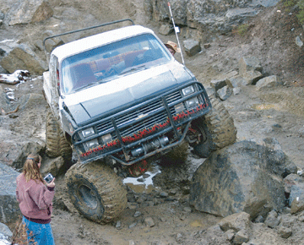
Four Wheel Drive
More number of motors = More torque (Obvious, by addition of torques)
Makes it easier to climb an inclined plane.
Make sure all four motors make contact with the ground (Otherwise the fourth motor is useless XD)
If the motors are of different RPM (with same size wheels)
If the front and rear are different = Power loss, Slipping, No control
Two sides different = Bot cannot go in a straight line (Very hard to control)

Slide 8
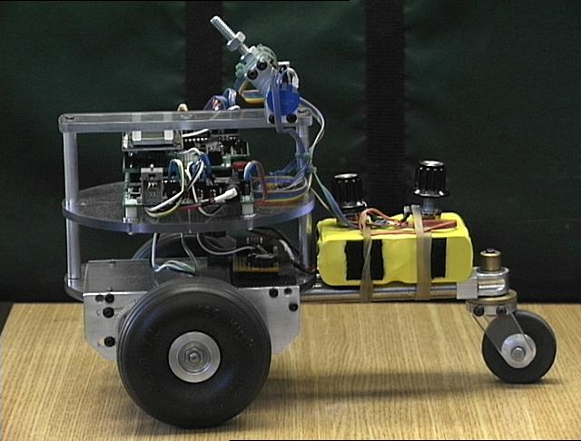
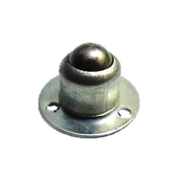
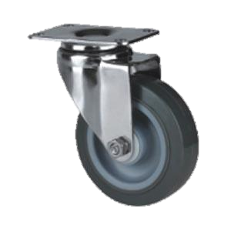
Three Wheel Drive
Minimum no of points to form a plane so very stable on any surface (plane or terrain).
Wheels always in contact with the ground.
Only two rear motors
Less power consumption ☺ (Battery lasts long)
Less torque ☹ (Difficult to climb incline)
The front wheel is a caster wheel which is undriven.

Slide 9
Steering Mechanisms
Differential Mechanism
Axle Mechanism
Rack and Pinion

Slide 10
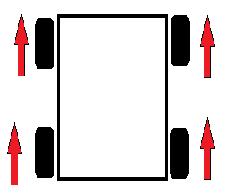
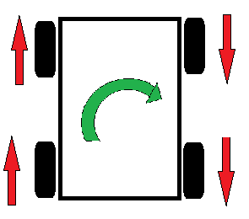
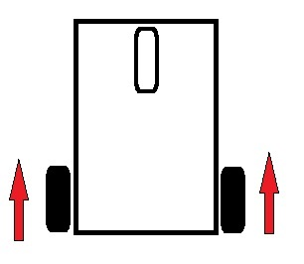
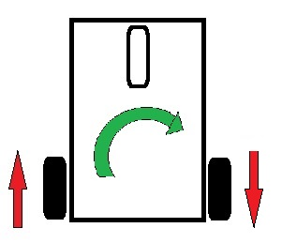
Differential Mechanism
The bot can steer by taking advantage of the relative motion of the wheels.
Pros and Cons:
Zero turning radius, i.e. turning axis is on the bot itself (Great for making sharp turns)
No need of any new motors for steering.
High RPM motors are not recommended!!!

Slide 11
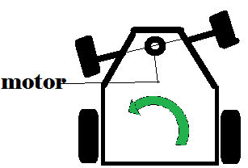
Axle Mechanism
A motor is placed vertically to turn the axle.
The other motors used are attached only to rear wheels.
The motor used for turning must have very less rpm around 10-30 rpm.
Pros and Cons:
Cannot make sharp turns and not very quick in response.
Accurate steering is not possible as motors don’t stop instantaneously when switched off.
Higher RPM motors could be used resulting in faster bots!!!

Slide 12
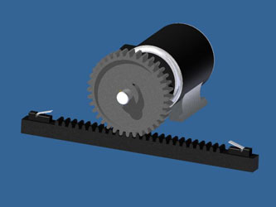
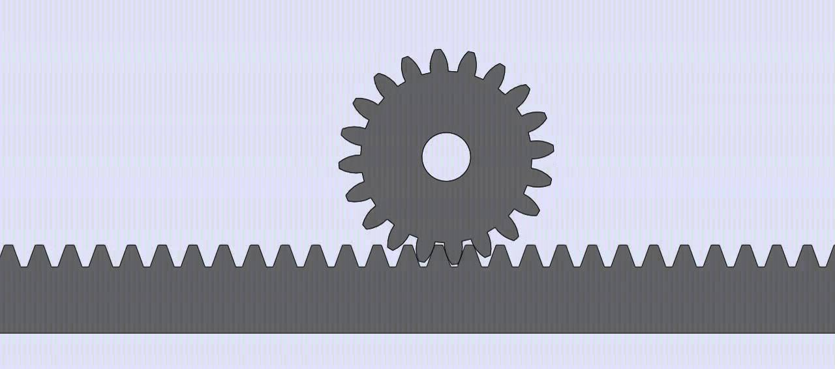
Rack and Pinion
A similar sort of steering is used in real cars.
Again, here only one or two motors are used for the rear wheels. (This means longer battery life but lesser torque)
One motor is required for steering.
Pinion
Rack

Slide 13
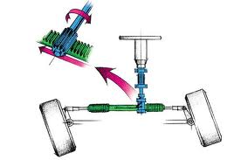
Rack and Pinion in a Steering System

Slide 14
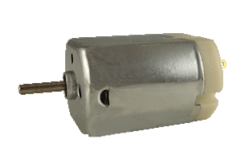
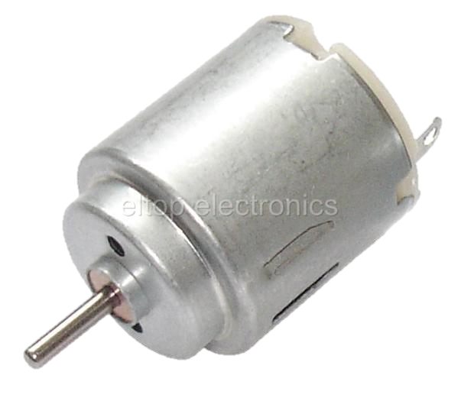
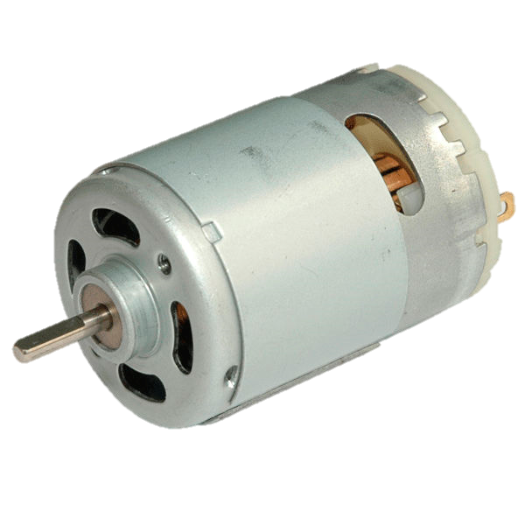
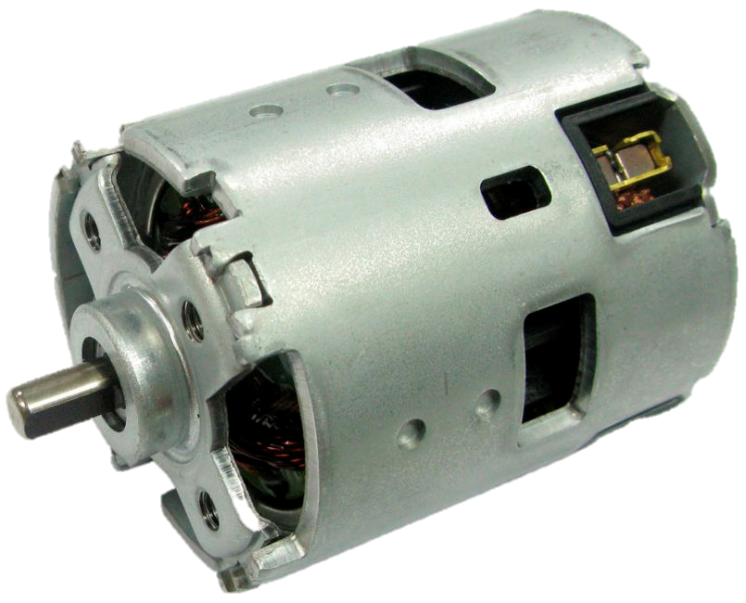
Motors

Slide 15

Motors

Slide 16
Types of Motors
Plastic BO motors are used if the bot needs to be light weight but they have a weak shaft and lesser torque.
Metal motors are heavy, but they have strong and reliable gears. (Most preferred)
Servo motors:
Can rotate to specified angles.
Makes use of an encoder.
Quite accurate.
A microcontroller is needed to control.

Slide 17
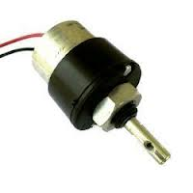
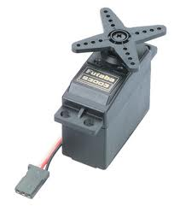
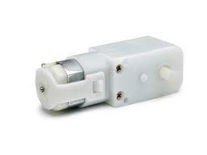
Types of Motors
BO Motor
Servo Motor
Metal DC Motor

Slide 18
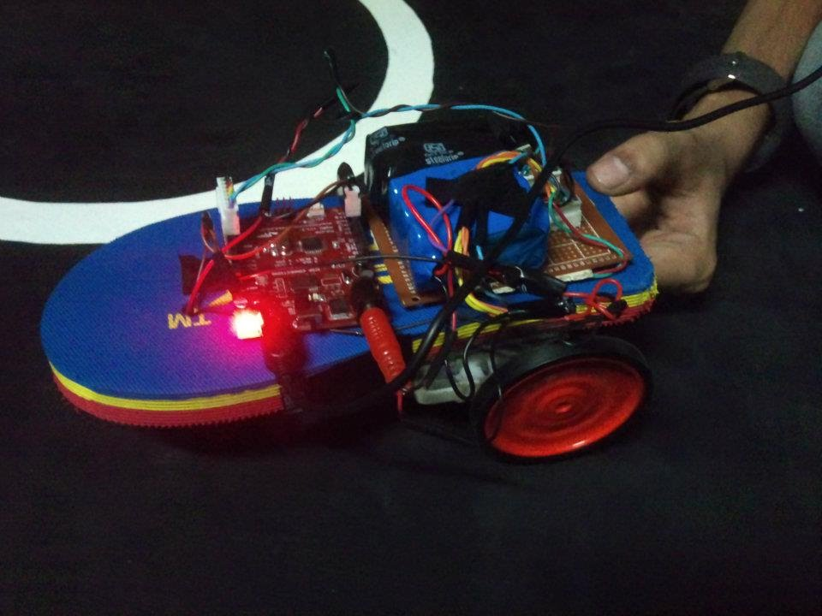
Material for Chassis
Acrylic
Aluminium
Wood

Slide 19
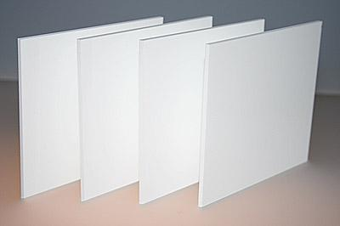
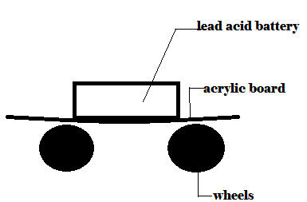
Acrylic
Advantages:
Lightweight.
Easy to work with (cut & drill).
Transparent sheets are available which can be used in robots where internal mechanism are to be displayed.
Disadvantages:
On application of load it bends.
Brittle & fragile.
Unable to sustain shocks and powerful jerks during impact or jumps.
Not reliable for long term usage of machine.

Slide 20
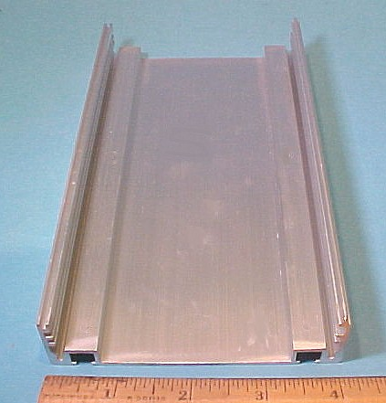
Aluminium
Advantages:
Lightweight.
Easy milling (compared to other metals).
Readymade sections, bars, boxes, etc. are easily available in the market which can be directly used.
Higher strength to weight ratio.
Disadvantages:
Sheet of same dimension is very heavy as compared to the other two materials.

Slide 21
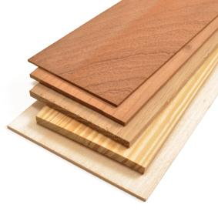
Wood
Advantages:
Lightest among the three.
Relatively cheaper than acrylic.
Easy to work with.
Disadvantages:
Weaker than aluminum.
Not Waterproof.

Slide 22
Battery
We generally use 4 types of batteries:
Lead-acid battery – Rechargeable (generally used)
Lithium Ion (Li-ion) battery
Lithium Polymer (Lipo)
Nickel Metal Hydride (Ni-MH) battery

Slide 23
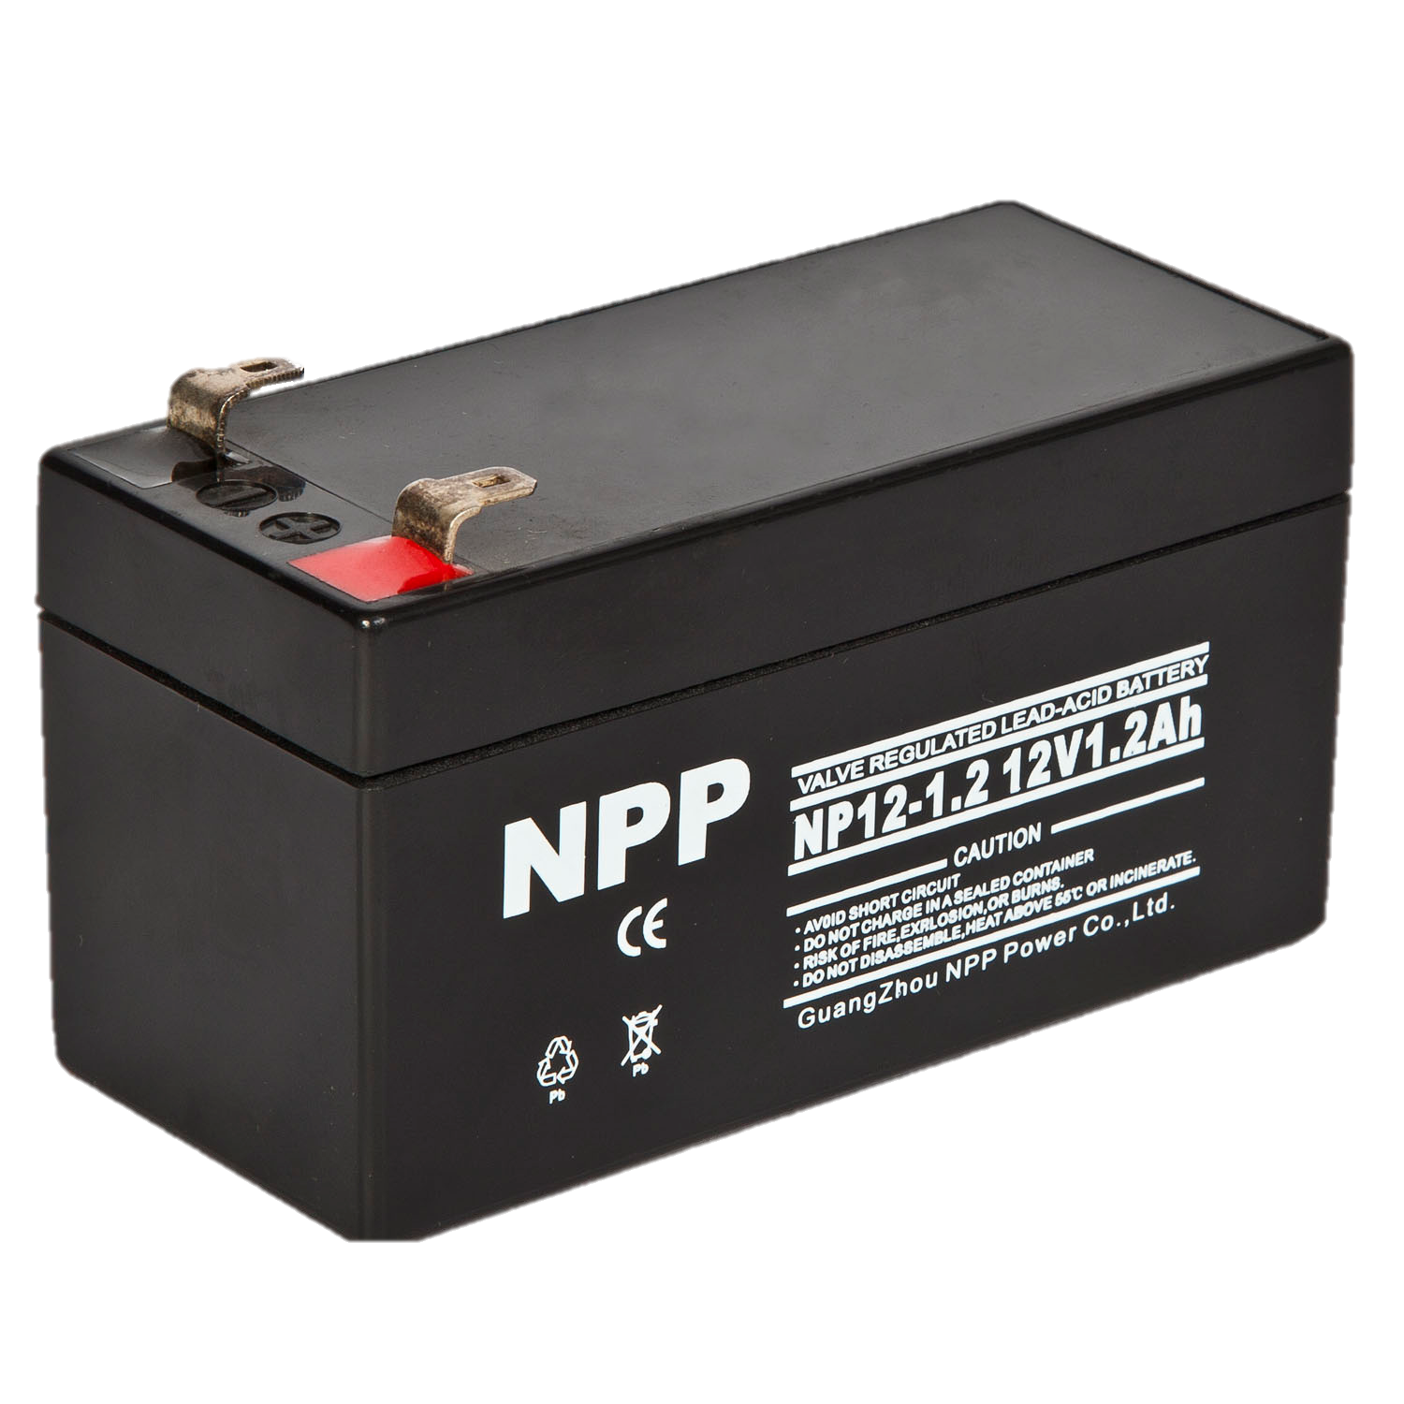
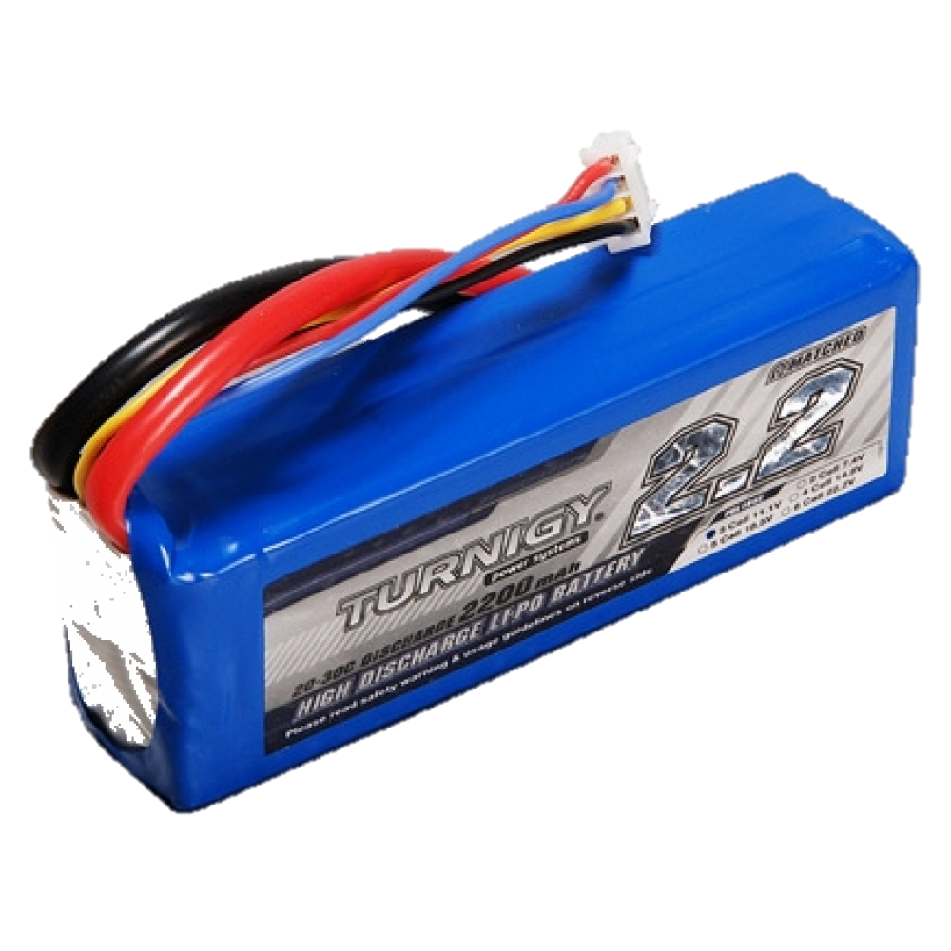
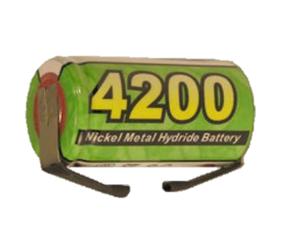
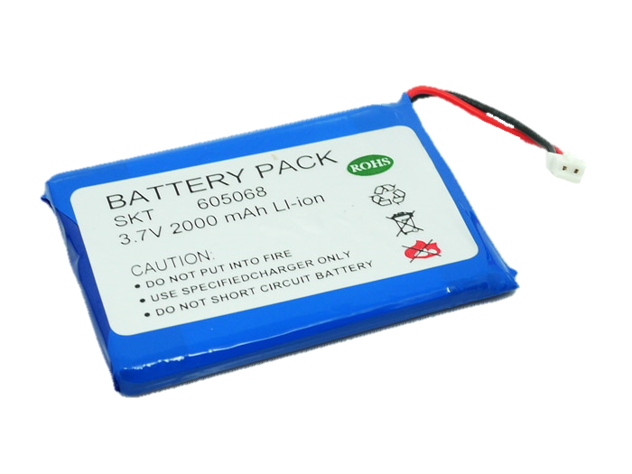
Which Battery to Use?
Lead acid batteries- Heavy , cheap, easy and safe to use.
Lithium ion battery-light weight , costly , careful charging needed.
Lithium polymer- light weight , very costly , careful charging and balancing needed.
Nickel metal hydride-slightly heavy , safe to use.

Slide 24
Happy XLR8ing!!

Slide 25
Thank You

